Slide 1

GitHub Advanced Security
Notes:
たとえばあなたは企業のセキュリティ担当者だとします。セキュリティ担当者の最大のミッションはサイバー攻撃の脅威から自分の組織を守ることです。セキュリティ担当者のみならず、IT産業に関わるひとはみんな世界ではサイバーセキュリティの脅威にさらされており、開発環境のセキュリティ保護はこれまで以上に大切になっていることを知っています。しかしながら攻撃者もまた年々巧妙になっています。セキュリティ担当者の不断の努力に関わらず、世間ではサイバー攻撃の悲惨な被害が耐えません。

Slide 2


Critical security incidents that have occurred in recent years
Equifax's Failure to Apply Security Patches Led to 140 Million Sensitive Information Leaks (2017)
Marriott Hotel’s Code Vulnerability Led to Hacker Attack and Data Leak of 500 Million People (2018)
Vulnerability in the well-known OSS Product Log4j Caused a Zero-day Attack that Sent the Industry into a Panic (2021)

Slide 3


Hmm
What do we do?

Slide 4



Code Scanning
Secret Scanning
Dependency Review
GitHub Advanced Security
Code Scanning
Secret Scanning
Dependency Review

Slide 5

Code Scanning
Analyze code in GitHub repositories to find security vulnerabilities and coding errors.
Code push, Pull Requests, and Scheduled scans.
CodeQL, a code analysis engine developed by GitHub to automate security checks.

Slide 6
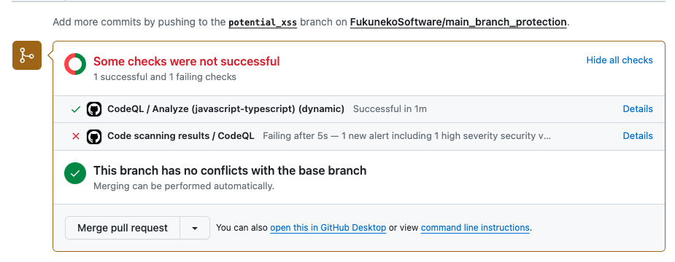
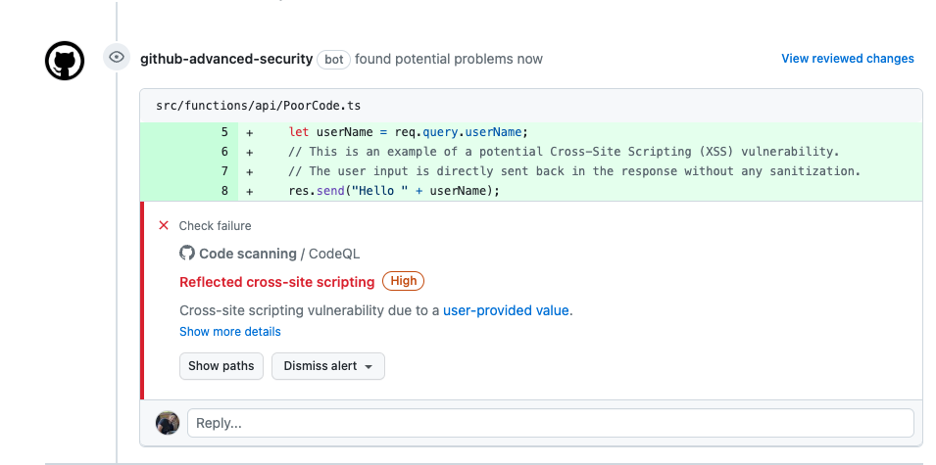
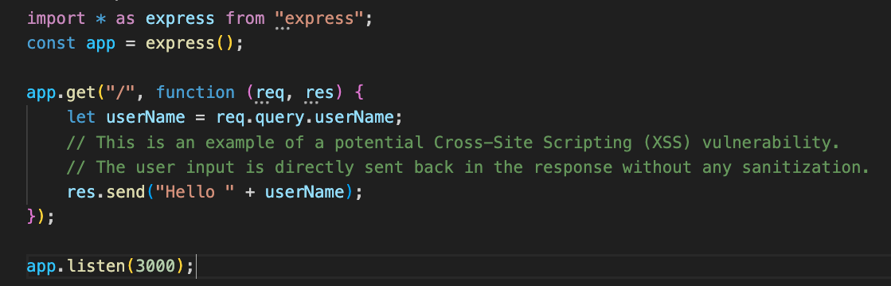
Stops it
from getting merged!
Detects it
at PR Stage!
Potential
XSS Vulnerability

Slide 7

Secret Scanning
Scan the code to find passphrases, connection strings, and other confidential information and alert us.
Offer suggestions on how to handle the secret leakage like rotation.
Push protection blocks commits containing the secret even before they are sent to the remote.

Slide 8
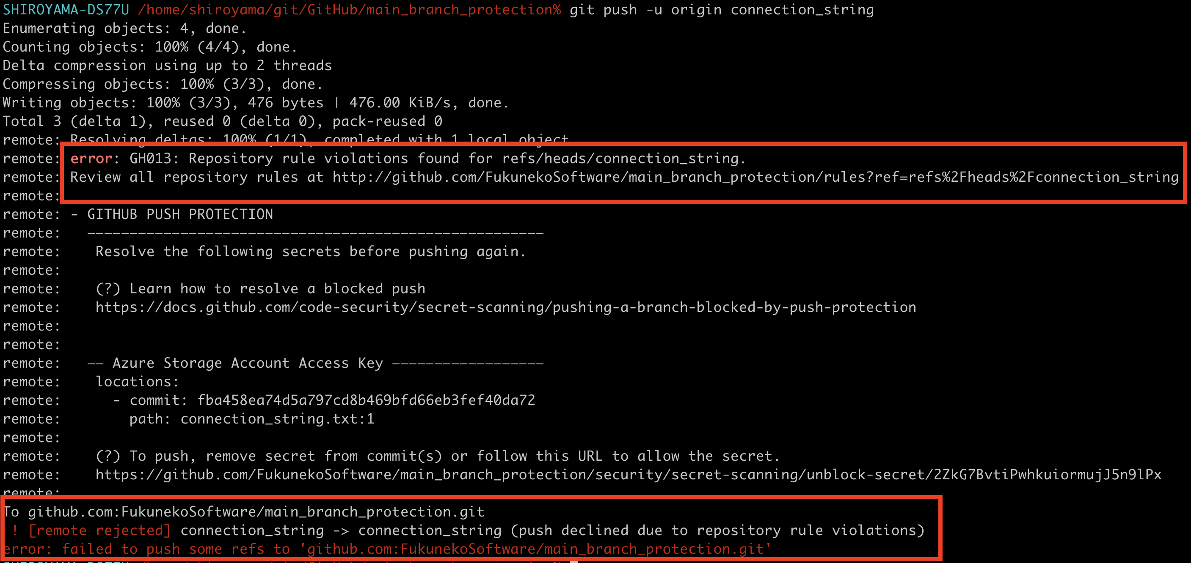
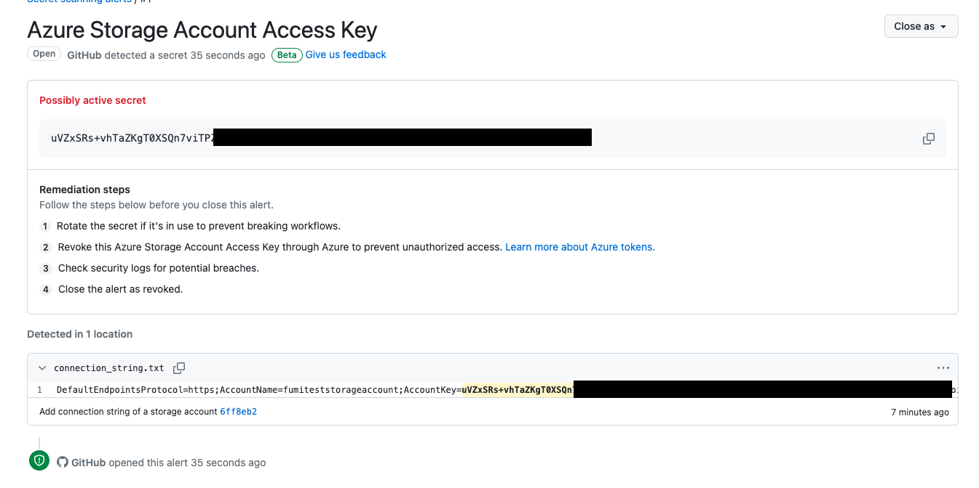
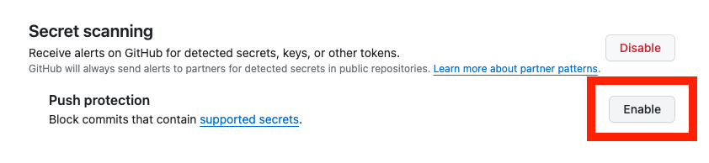
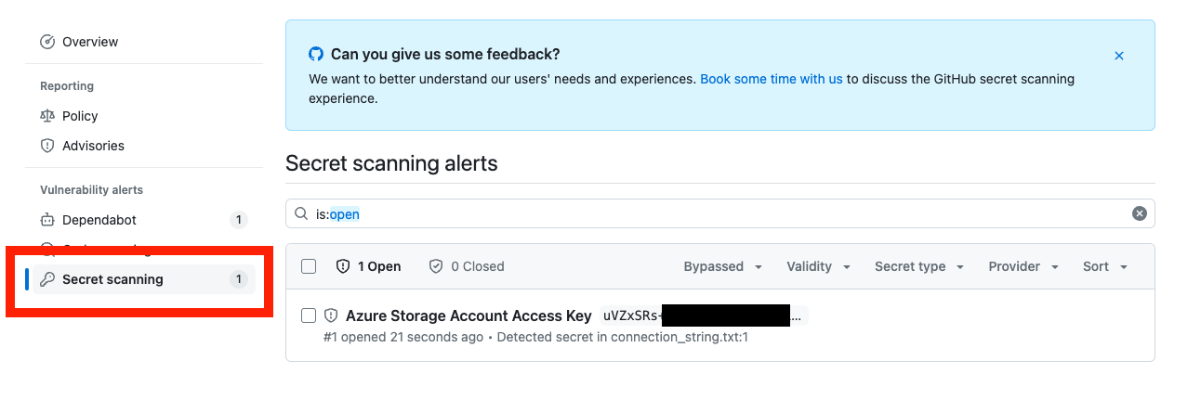
Suggestions on
how to handle this
Push rejected!
Leaked secret found!
Once “Push protection”
is enabled…

Slide 9

Dependency Review
Find and alert you to vulnerabilities in your code dependencies.
Dependabot will even make a PR for the upgrade.
Monitor the vast dependency tree of GitHub's public repositories to ensure that the most up-to-date information is always being incorporated.
This Photo by Unknown Author is licensed under CC BY

Slide 10
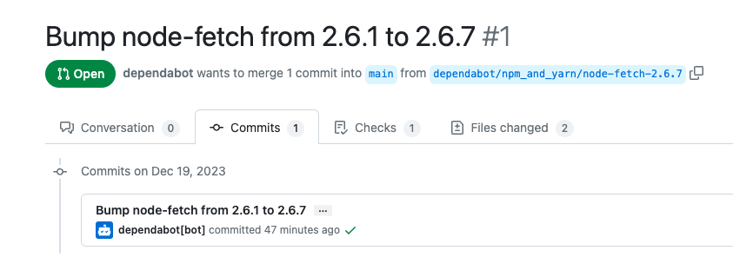
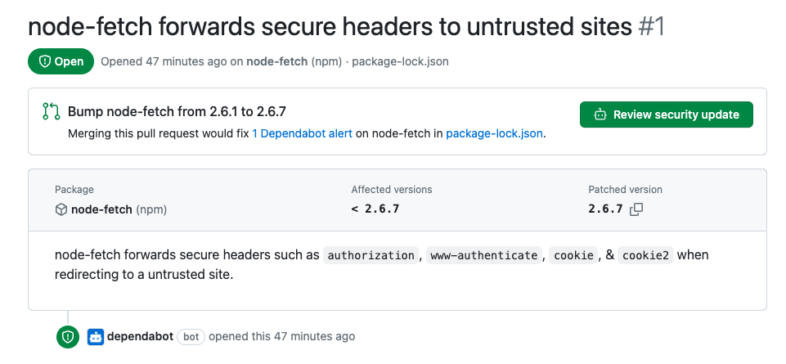
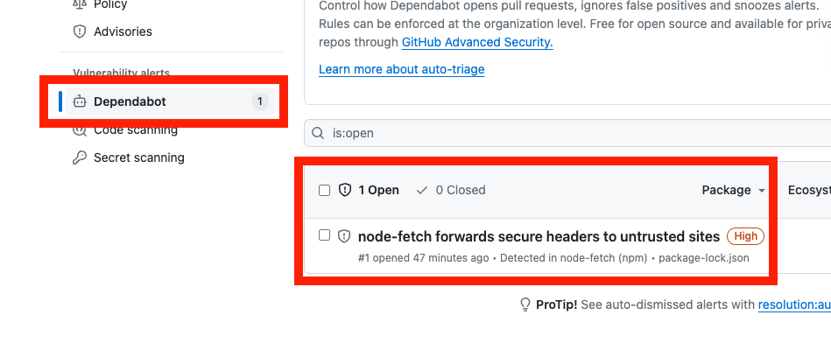
PR is
automatically created
Vulnerability
details
Dependabot
detects vulnerability
This Photo by Unknown Author is licensed under CC BY

